Slide 1

Bike Sales performance Excel Dashboard
By Aditi Agarwal

Slide 2
INDEX
Index number | Contents
01 | Introduction
02 | Overview of Bike Sales
03 | Consolidated dashboard
04 | Key findings
05 | Charts and graphs
06 | Recommendations

Slide 3
INTRODUCTION
The main objective of this project of making an interactive Excel dashboard is to analyze and track bike sales performance to understand different factors that are considered by customers before making a purchase decision.
Businesses and analysts understand the factors influencing bike purchases and tailor marketing strategies accordingly.
It will also identify potential target demographics and geographical areas for more effective bike sales and promotions.

Slide 4
Project Overview
Customer analysis
Customer analysis
Geographical analysis
Included some questions and answers to understand the dashboard better in a subjective manner.
First analysis was based on the customers including their age, income, gender.
Second analysis was based on the regions, commute distance affecting the sales. .

Slide 5
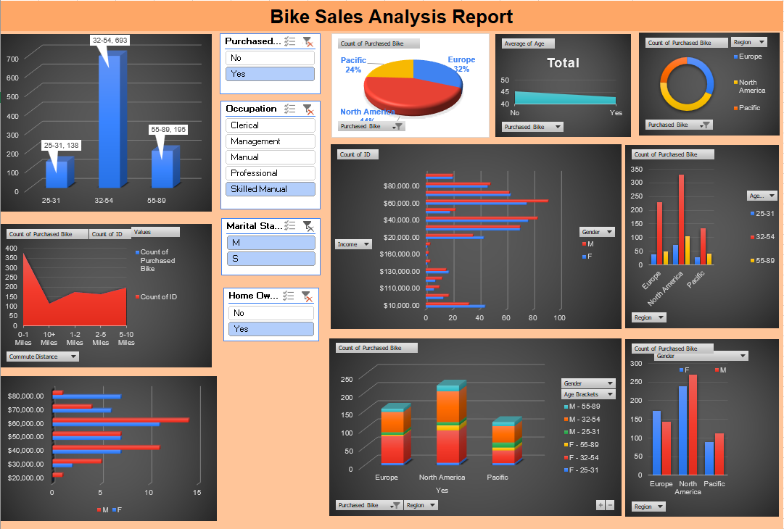

Slide 6
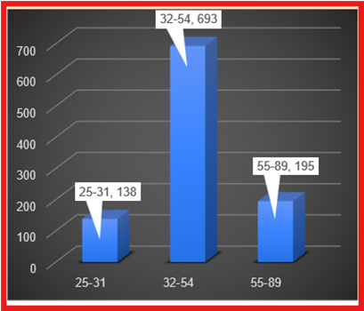
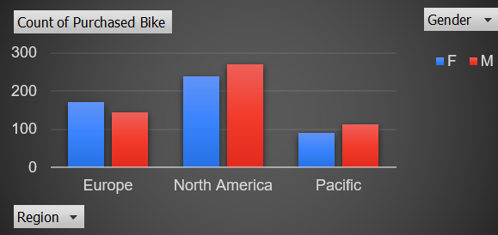
Key Findings
Bike Purchase by Age Brackets:
Highest Number of Bikes (693) were purchased by middle aged people ranging between 32-54 years.
In every region , Males have more purchase count than females.

Slide 7
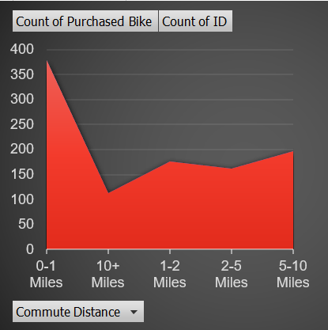
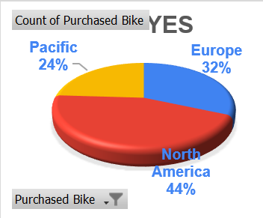
If commute distance increases , the purchases or the people who make a purchase decreases
Region – North America
It has the highest sales of bikes (44%)

Slide 8
Recommendations
Targeted Marketing Strategies: Based on age brackets and income insights, tailor marketing campaigns to resonate with specific demographic groups more likely to purchase bikes.
Regional Focus: Allocate resources to regions showing higher bike sales potential and consider localized promotions based on regional commuting habits.
Product Customization: Use insights into customer demographics and purchase patterns to potentially offer customized bike models that cater to specific preferences identified in the data.
Data Collection Improvement: Consider expanding data collection to include additional variables like bike model preferences or reasons for purchase decisions to enhance future analyses.

Slide 9
THANK YOU ☺

